Slide 1

Sorting Techniques: Insertion Sort
Data Structure | Searching and Sorting
Course: Data Structure | Chapter: Searching and Sorting | Program: Bachelor of Engineering
DISCOVER · LEARN · EMPOWER
Notes:
Welcome everyone to today's lecture on Insertion Sort. This topic is a fundamental part of our unit on Searching and Sorting. As we begin, remember that mastering these basic algorithms is crucial for your engineering career. Let us dive into how we can sort data efficiently.

Slide 2
Course Outcomes
SLIDE 2 / 10
Course Outcome
CO | BT LEVEL | DESCRIPTION
CO1 | BT1 | Understand and apply basic data structures, algorithms, complexity analysis, ADTs, arrays and linked lists.
CO2 | BT2 | Apply and implement stacks and queues in problem-solving.
CO3 | BT3 | Analyse and apply searching, sorting, and hashing techniques.
CO4 | BT4 | Construct and apply tree structures and traversal techniques.
CO5 | BT5 | Represent and solve graph problems using DFS, BFS, and graph algorithms.
Chandigarh University
2 / 10
Notes:
Today's lecture directly addresses our Course Outcomes. CO1 is met as we analyze the Insertion Sort algorithm and its complexity. Although CO5 focuses on graphs, the logical thinking required for sorting algorithms builds the foundation for solving complex graph traversal problems later.

Slide 3
Learning Objectives
SLIDE 3 / 10
Learning Outcomes
1
Define the concept of Insertion Sort and its basic working principle.
2
Trace the step-by-step execution of the algorithm on a sample array.
3
Analyze the time complexity for best, average, and worst cases.
4
Compare the efficiency of Insertion Sort with other basic sorting methods.
Chandigarh University
3 / 10
Notes:
By the end of this session, you will be able to define Insertion Sort clearly. You will trace how an unsorted array becomes sorted step-by-step. We will also analyze the time complexity to understand when this algorithm is most useful. Finally, we will compare it briefly with other methods to see its place in the broader context.

Slide 4
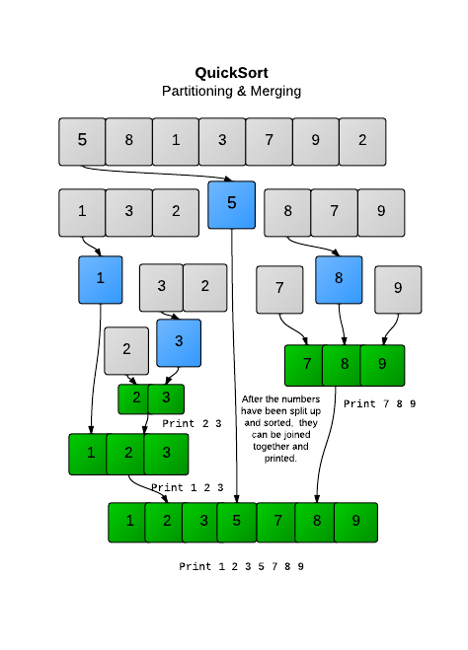
Lecture
SLIDE 4 / 10
Definition and Working Principle
1
Insertion Sort builds the final sorted array one item at a time.
2
It works by picking an element and inserting it into its correct position.
3
The algorithm maintains a sorted sub-list on the left side of the array.
4
Elements are compared with the sorted sub-list to find the insertion point.
5
This process repeats until all elements are placed in their correct positions.
Quicksort 2 - Sorting | HackerRank
Chandigarh University
4 / 10
Notes:
Think of Insertion Sort like sorting a hand of playing cards. You pick up one card at a time and place it in the correct spot among the cards you are already holding. The left side of the array is always sorted, while the right side remains unsorted. We take the first element of the unsorted part and insert it into the sorted part.

Slide 5
Lecture
SLIDE 5 / 10
Step-by-Step Execution Logic
1
Start with the second element as the key to be inserted into the sorted part.
2
Compare the key with elements in the sorted sub-list from right to left.
3
Shift elements greater than the key one position ahead to make space.
4
Insert the key into the correct position once the proper spot is found.
5
Repeat this process for every subsequent element until the entire array is sorted.
Chandigarh University
5 / 10
Notes:
Let's look at the logic in detail. We start with the second element, treating it as our 'key'. We compare this key with the elements to its left. If the key is smaller, we shift the larger element to the right. We keep shifting until we find the correct spot for the key. This ensures the left side remains sorted after every iteration.

Slide 6
Lecture
SLIDE 6 / 10
Worked Numerical Example
INITIAL ARRAY
[12, 11, 13, 5, 6]
• Iteration 1: Key is 11; shift 12 right; Array becomes [11, 12, 13, 5, 6].
• Iteration 2: Key is 13; no shift needed; Array remains [11, 12, 13, 5, 6].
• Iteration 3: Key is 5; shift 13, 12, 11 right; Array becomes [5, 11, 12, 13, 6].
• Iteration 4: Key is 6; shift 13, 12, 11 right; Final Array [5, 6, 11, 12, 13].
Chandigarh University
6 / 10
Notes:
Let's trace this with the array [12, 11, 13, 5, 6]. First, we take 11 and place it before 12. Next, 13 is already in order. Then comes 5, which is smaller than all previous elements, so we shift 12, 11, and 13 to the right. Finally, 6 is inserted between 5 and 11. The array is now fully sorted.

Slide 7
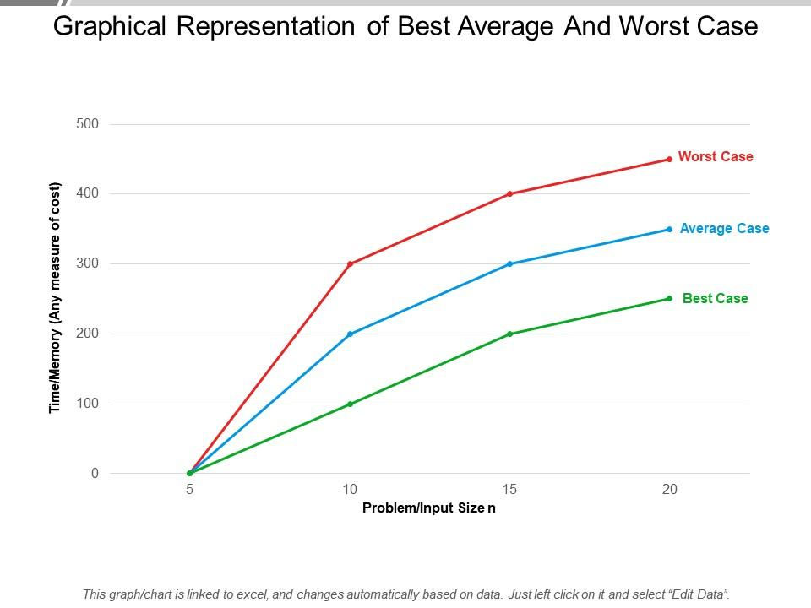
Lecture
SLIDE 7 / 10
Time Complexity Analysis
BEST CASE
O(n) occurs when the array is already sorted.
AVERAGE CASE
O(n²) occurs when elements are in random order.
WORST CASE
O(n²) occurs when the array is sorted in reverse order.
SPACE COMPLEXITY
O(1) as the sorting is done in-place without extra memory.
• The number of comparisons and shifts determines the total execution time.
Source: www.slideteam.net
Chandigarh University
7 / 10
Notes:
The performance of Insertion Sort depends heavily on the initial order of data. If the array is already sorted, we only need one pass, making it O(n). However, if the array is reverse sorted, we must shift every element for every key, leading to O(n²). Despite the quadratic time, it uses constant space, making it memory efficient.

Slide 8

Lecture
SLIDE 8 / 10
Advantages and Disadvantages
ADVANTAGE
Simple to implement and requires minimal code logic.
ADVANTAGE
Efficient for small data sets or nearly sorted data arrays.
ADVANTAGE
Stable sort that maintains the relative order of equal elements.
DISADVANTAGE
Inefficient for large data sets due to O(n²) complexity.
DISADVANTAGE
Requires many element shifts which can be time-consuming.
Source: blog.infodiagram.com
Chandigarh University
8 / 10
Notes:
Why use Insertion Sort? It is incredibly simple and stable, meaning equal elements keep their original order. It is also very fast for small lists or lists that are almost sorted. However, for large datasets, the quadratic time complexity makes it impractical compared to faster algorithms like Merge Sort or Quick Sort.

Slide 9
Lecture
SLIDE 9 / 10
Key Takeaways
1
Insertion Sort builds the sorted array one element at a time.
2
It works by shifting larger elements to the right to make space.
3
Time complexity is O(n) for best case and O(n²) for average/worst cases.
4
The algorithm is stable and sorts in-place with O(1) extra space.
5
It is ideal for small datasets or nearly sorted data sequences.
Chandigarh University
9 / 10
Notes:
To summarize, Insertion Sort is a simple, stable algorithm that builds the sorted array incrementally. Remember that its efficiency drops significantly for large datasets due to the O(n²) complexity. However, for small or nearly sorted lists, it is often the most efficient choice. Always consider the data size before selecting this algorithm.

Slide 10
Lecture
SLIDE 10 / 10
References
DATA STRUCTURES
A Pseudocode Approach with C — Gilberg, Forouzan
• Data Structures — Lipschutz
• Data Structure Using C — AK Sharma
• C and Data structure — P. S. Deshpandey
Chandigarh University
10 / 10
Notes:
These four books provide comprehensive coverage of data structures and algorithms. I recommend Gilberg and Forouzan for a pseudocode approach, and Lipschutz for clear theoretical explanations. Sharma and Deshpandey offer excellent practical examples using the C language. Please refer to these texts for further study and practice problems.

